Slide 1

NYPD Shooting Incidents Dataset Analysis
Ray

Slide 2
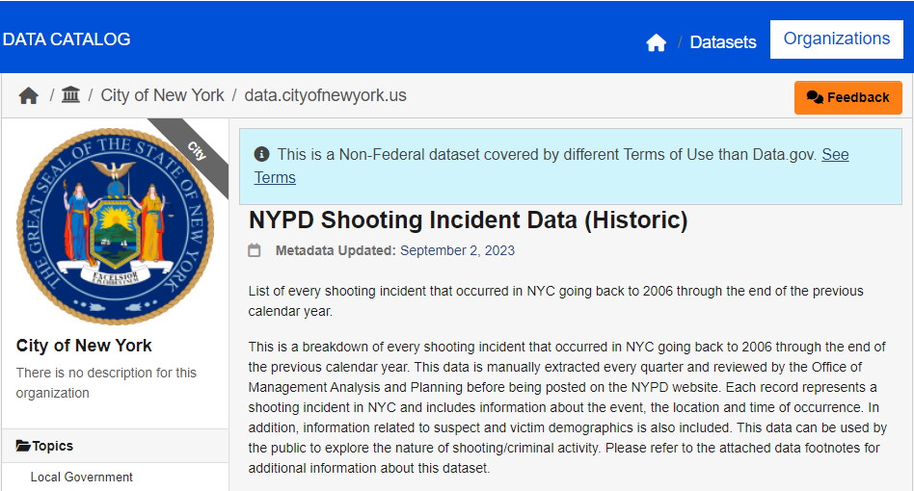
Data Source
URL: https://catalog.data.gov/dataset/nypd-shooting-incident-data-historic
Notes:
The Home of the U.S. Government's Open Data

Slide 3
What questions I am interested in
1.How many incidents are in each borough?
2.What are the year-to-year trends in the number of total shootings in New York City?
3.Can I generate a model to simulate the overall trend?

Slide 4
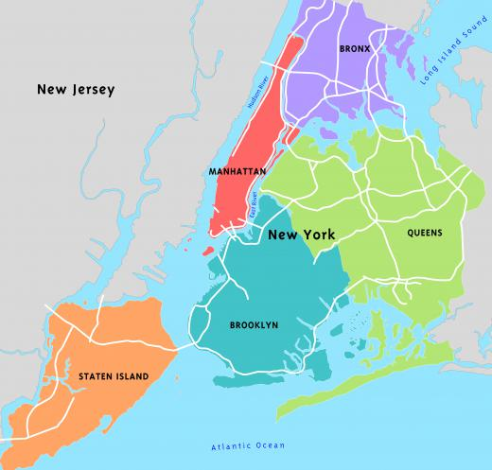
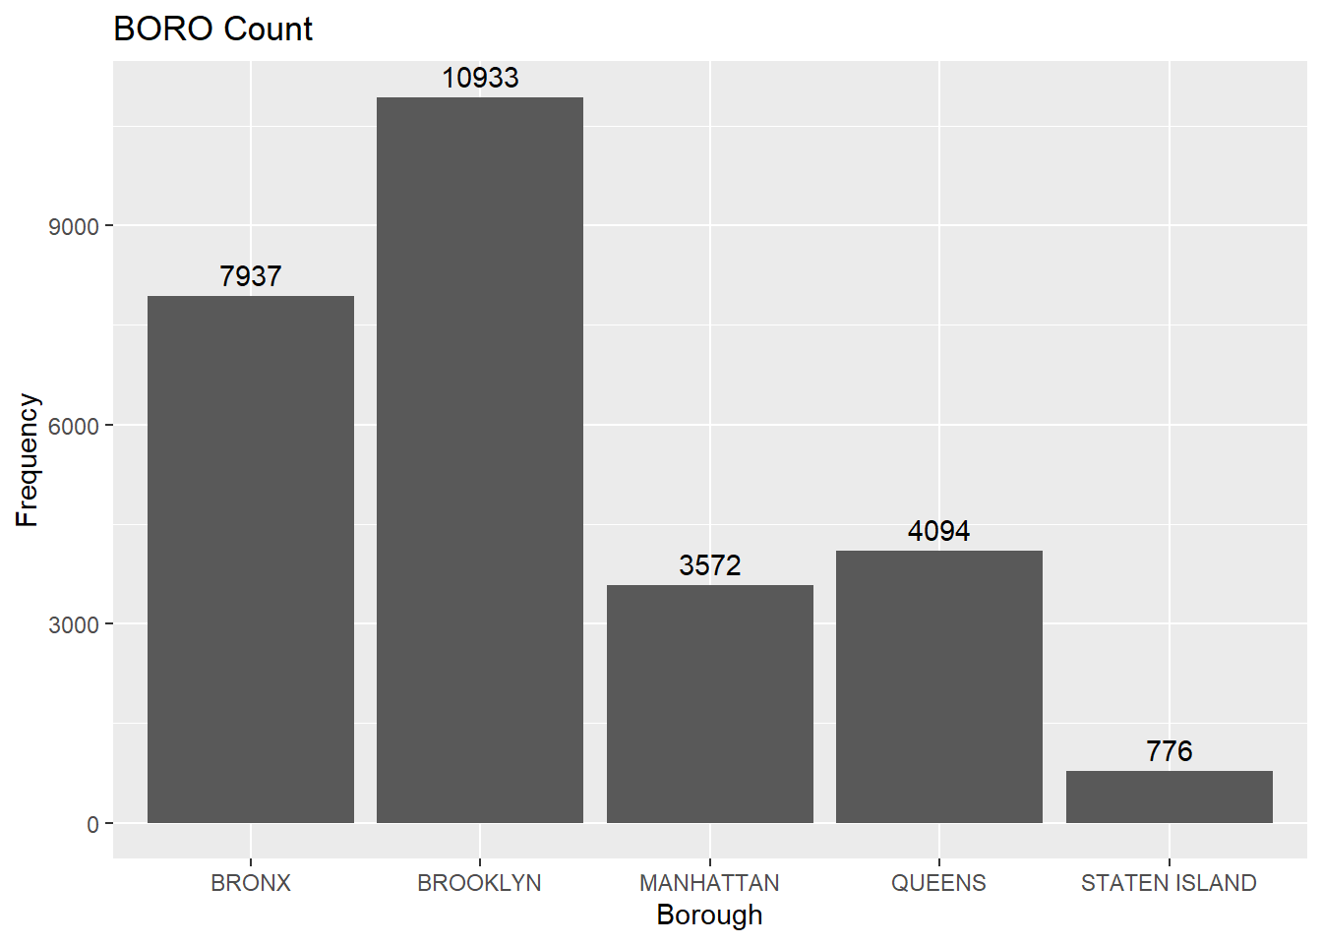
Numbers of boroughs’ shooting incidents

Slide 5
Bias and Analysis
1.5 million
42.4 mile ²
Causes of crime
Rapid Population growth
Lack of social welfare
Pandemic
Local unemployment
High percent of rental housing
Political neglect
Lack of social capital
1.7 million
22.8mile ²
2.4 million
109.7 mile ²
0.5 million
58.5 mile ²
2.7 million
71.5 mile ²
Population data (2021) was investigated by the Census Bureau

Slide 6
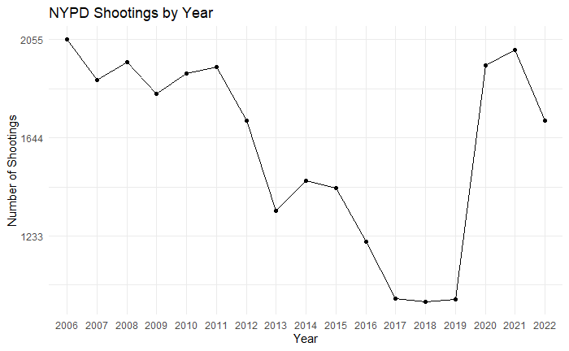
Number of NYPD shooting incidents over the years
Pandemic in Jan, 2020

Slide 7
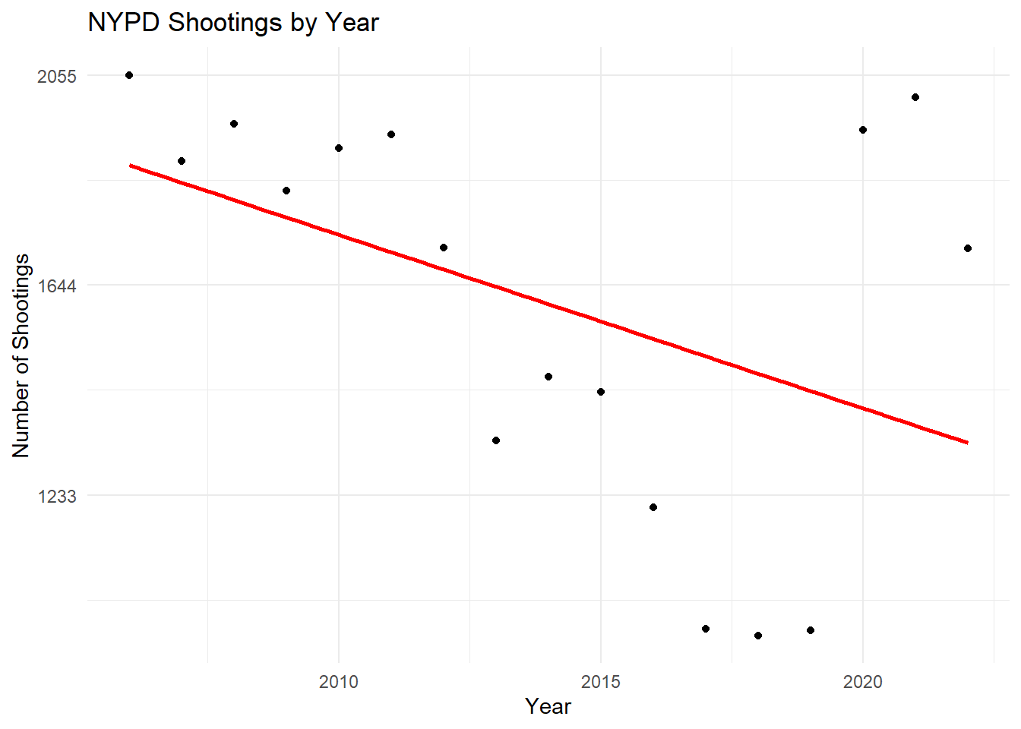
Linear regression

Slide 8
Thanks for your attention

